Slide 1

IDENTIFYING THE COVID-19 SYMPTOMS
Presented By Team-
HACKVID-19
INSTITUTION-
Sathyabama Institute Of Science and Technology
Team Members-
R. Saloni Jain
Anupriya Soni
M Shweta Singha
Sangeeta Burman
Mentored By:-
Dr. Sugadev

Slide 2
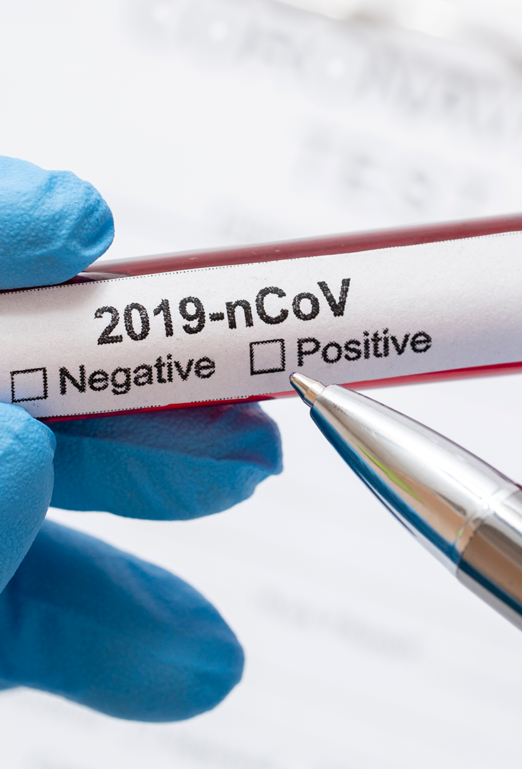
INTRODUCTION
As we know, the entire world is facing a very grave pandemic i.e. COVID-19.The virus is constantly changing its characteristics therefore it is becoming difficult for us to detect the symptoms.
Our goal is to develop an application for android phones as well as a hardware device i.e a Bluetooth Infrared Thermal Camera that can be attached with the cell phone itself to identify the various symptoms of COVID-19.
With the help of this application we can easily analyze the exixting symptoms as well as any new symptoms . We have a cough monitor as well that can alert us if we need any medical assistance.

Slide 3



OBJECTIVE
In many cases, the illness starts with a fever. Sometimes a cough accompanies it — maybe shortness of breath. But for people with a mild case of COVID-19, the disease caused by the new coronavirus, that may be the extent of unpleasant symptoms.
Our objective is to make a full-fledged application that can be helpful for early detection of covid symptoms and users can self assess themselves with the help of this app for any possible covid symptoms.
We can identify the existing symptoms as well as any new symptoms with the help of our android application which will have a survey to help analyze various symptoms and it will also have a cough monitoring feature as well as an helpline number active 24x7 and an external hardware device i.e Bluetooth Infrared Thermal Camera to detect the body temperature.With the help of the Bluetooth we can retrieve the data into our cell phones.

Slide 4
TECHNOLOGY USED
Bluetooth IR Thermal Camera
Android Studio
Firebase
To make the application that can run on any android device.
To store all the survey data on the database.
To detect body temperature and it will alert the user if body temperature exceeds 37.3 Celsius or 99 Fahrenheit.The camera can be attached to the cellphones
AI Based Device
By using neural computer engines.

Slide 5
HARDWARE DEVICE
In-built implemented device for cough detection in ANDROID development:-
A portable device powered by artificial intelligence (AI) which can detect coughing and crowd size in real time, then analyse the data to directly monitor trends in flu-like illness such as COVID-19.
The device is called as FLU-SENSE is envisioned for use in hospitals, healthcare waiting rooms and larger public spaces.
The models like these can be lifesavers by directly informing the public health response during a flu epidemic. This device may allow us to predict flu trends in a much more accurate manner. The FlU-SENSE platform process a low- cost microphone array and thermal imaging data with a RASPBERRY-PI and NEURAL COMPUTING engines. This device is developed a lab-based cough model.
Then they trained the algorithm to create thermal images representing people , and then to count them.

Slide 6
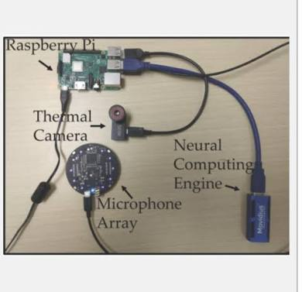

Slide 7
SOLUTION
SURVEY
BLUETOOTH INFRARED THERMAL CAMERA
This can be attached to android cell phones and will detect temperature by using Bluetooth protocol.
COUGH SEVERITY DETECTION
This will help us identify more and more covid patients and we will also have the data stored in the database to analyze any new symptoms.
This will help in monitoring cough frequency, whether it is severe or mild cough and will also identify wheezing problem
CHAT BOT AND HELPLINE
This will assist people in need and is made available 24x7 for any kind of medical related helps.

Slide 8
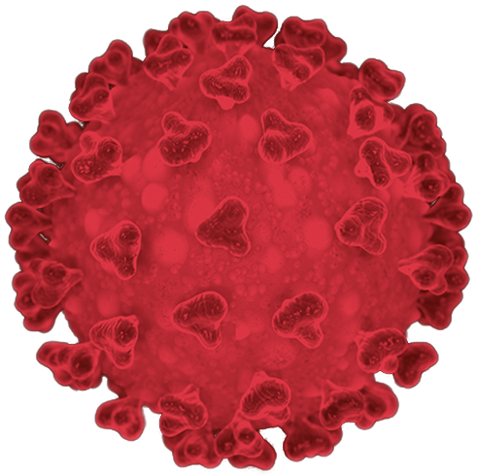



THANK YOU

